Slide 1

Lecture 7
SQL ll

Slide 2
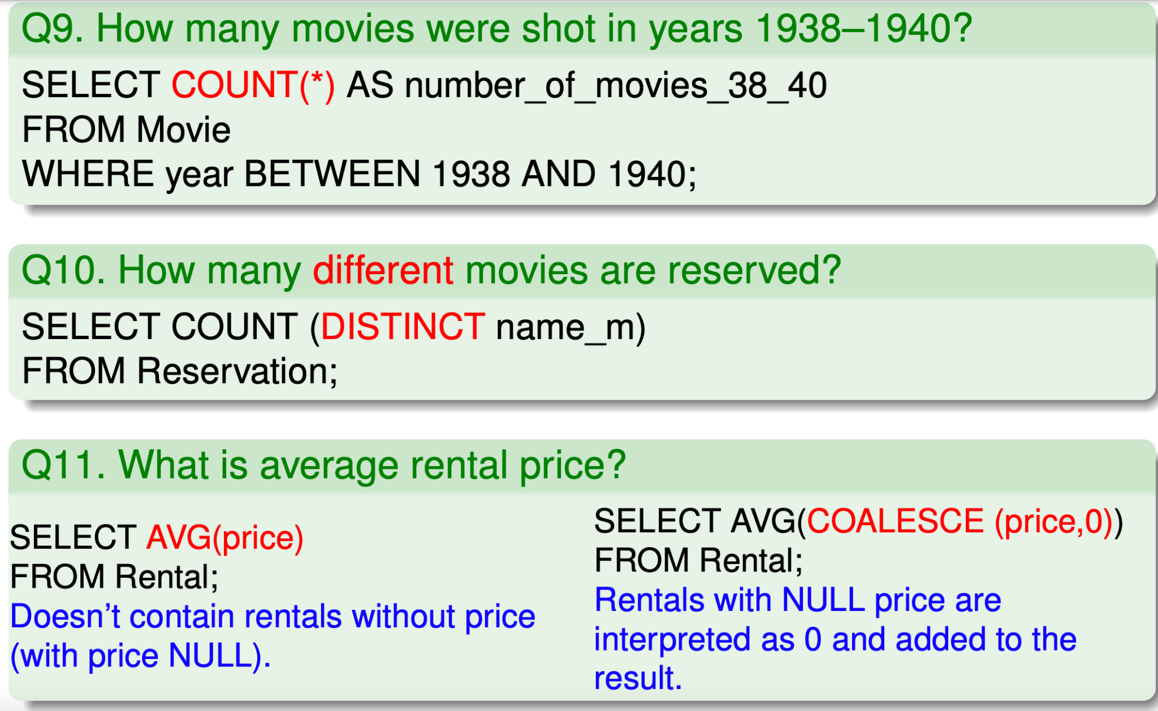
Aggregation

Slide 3
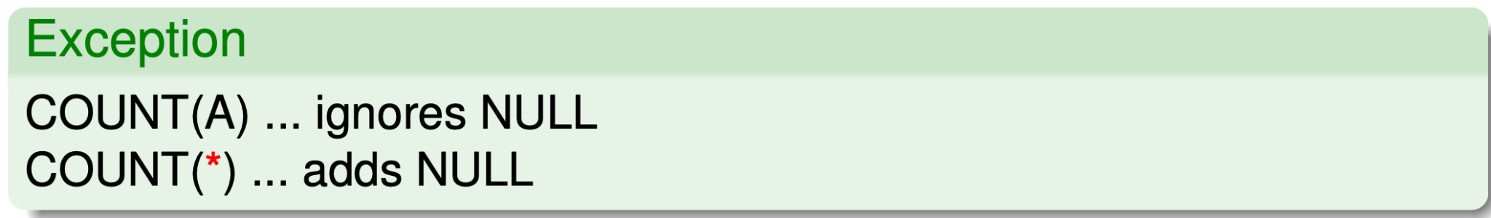
Aggregation functions
Syntax:
aggregation_function ([ALL | DISTINCT] column | expression) COUNT, SUM, MAX, MIN, AVG and others.
Calculation is done through the result rows.
What do we do with NULL values in the column?
What do we do with duplicate values in the column?
COUNT(∅) = 0

Slide 4
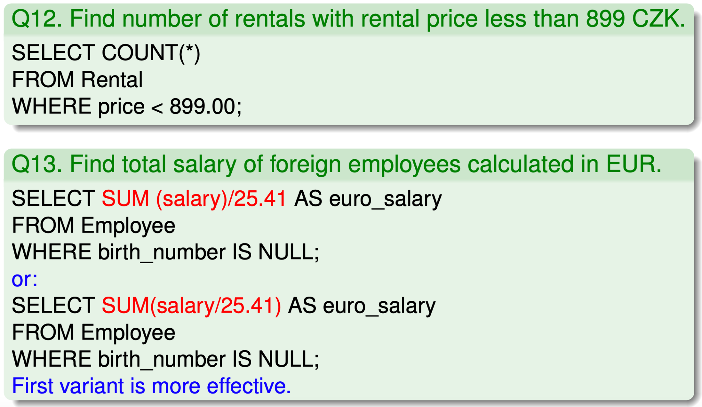
Aggregation functions

Slide 5
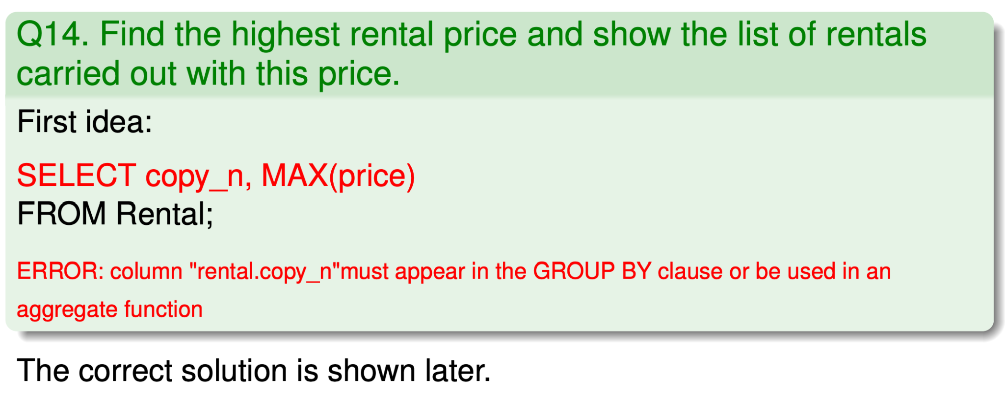
Row grouping

Slide 6
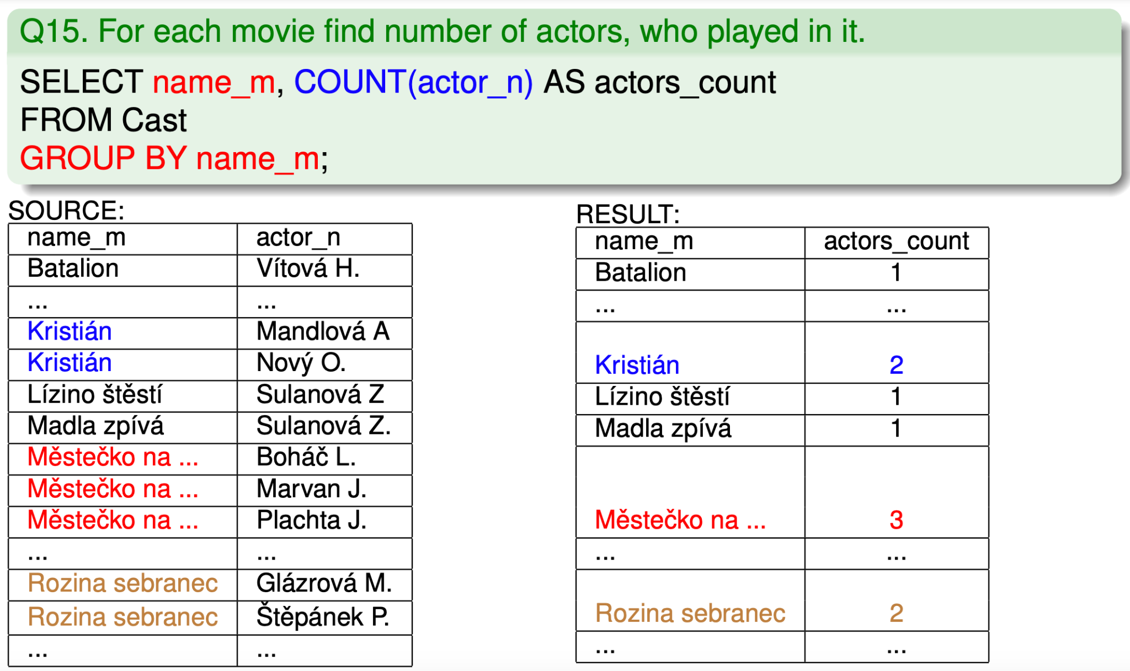
Row grouping (GROUP BY)

Slide 7
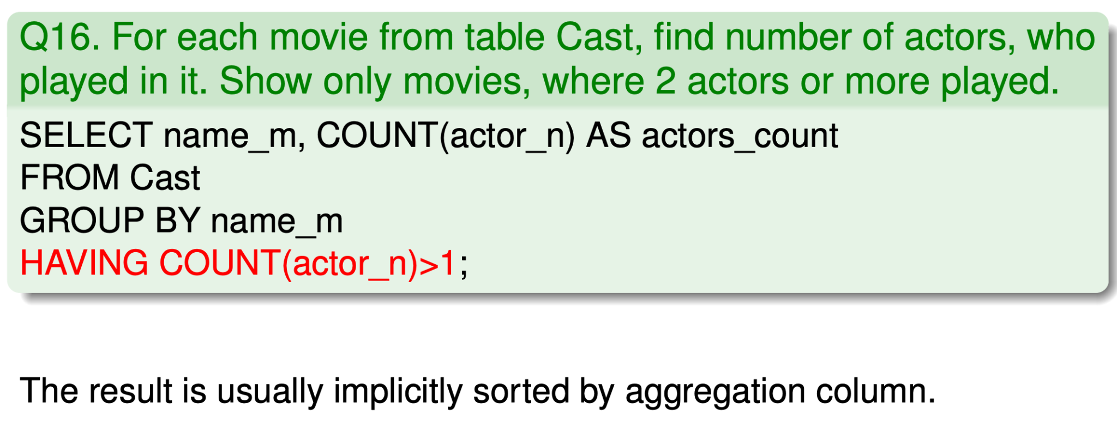
Rows grouping (HAVING)

Slide 8
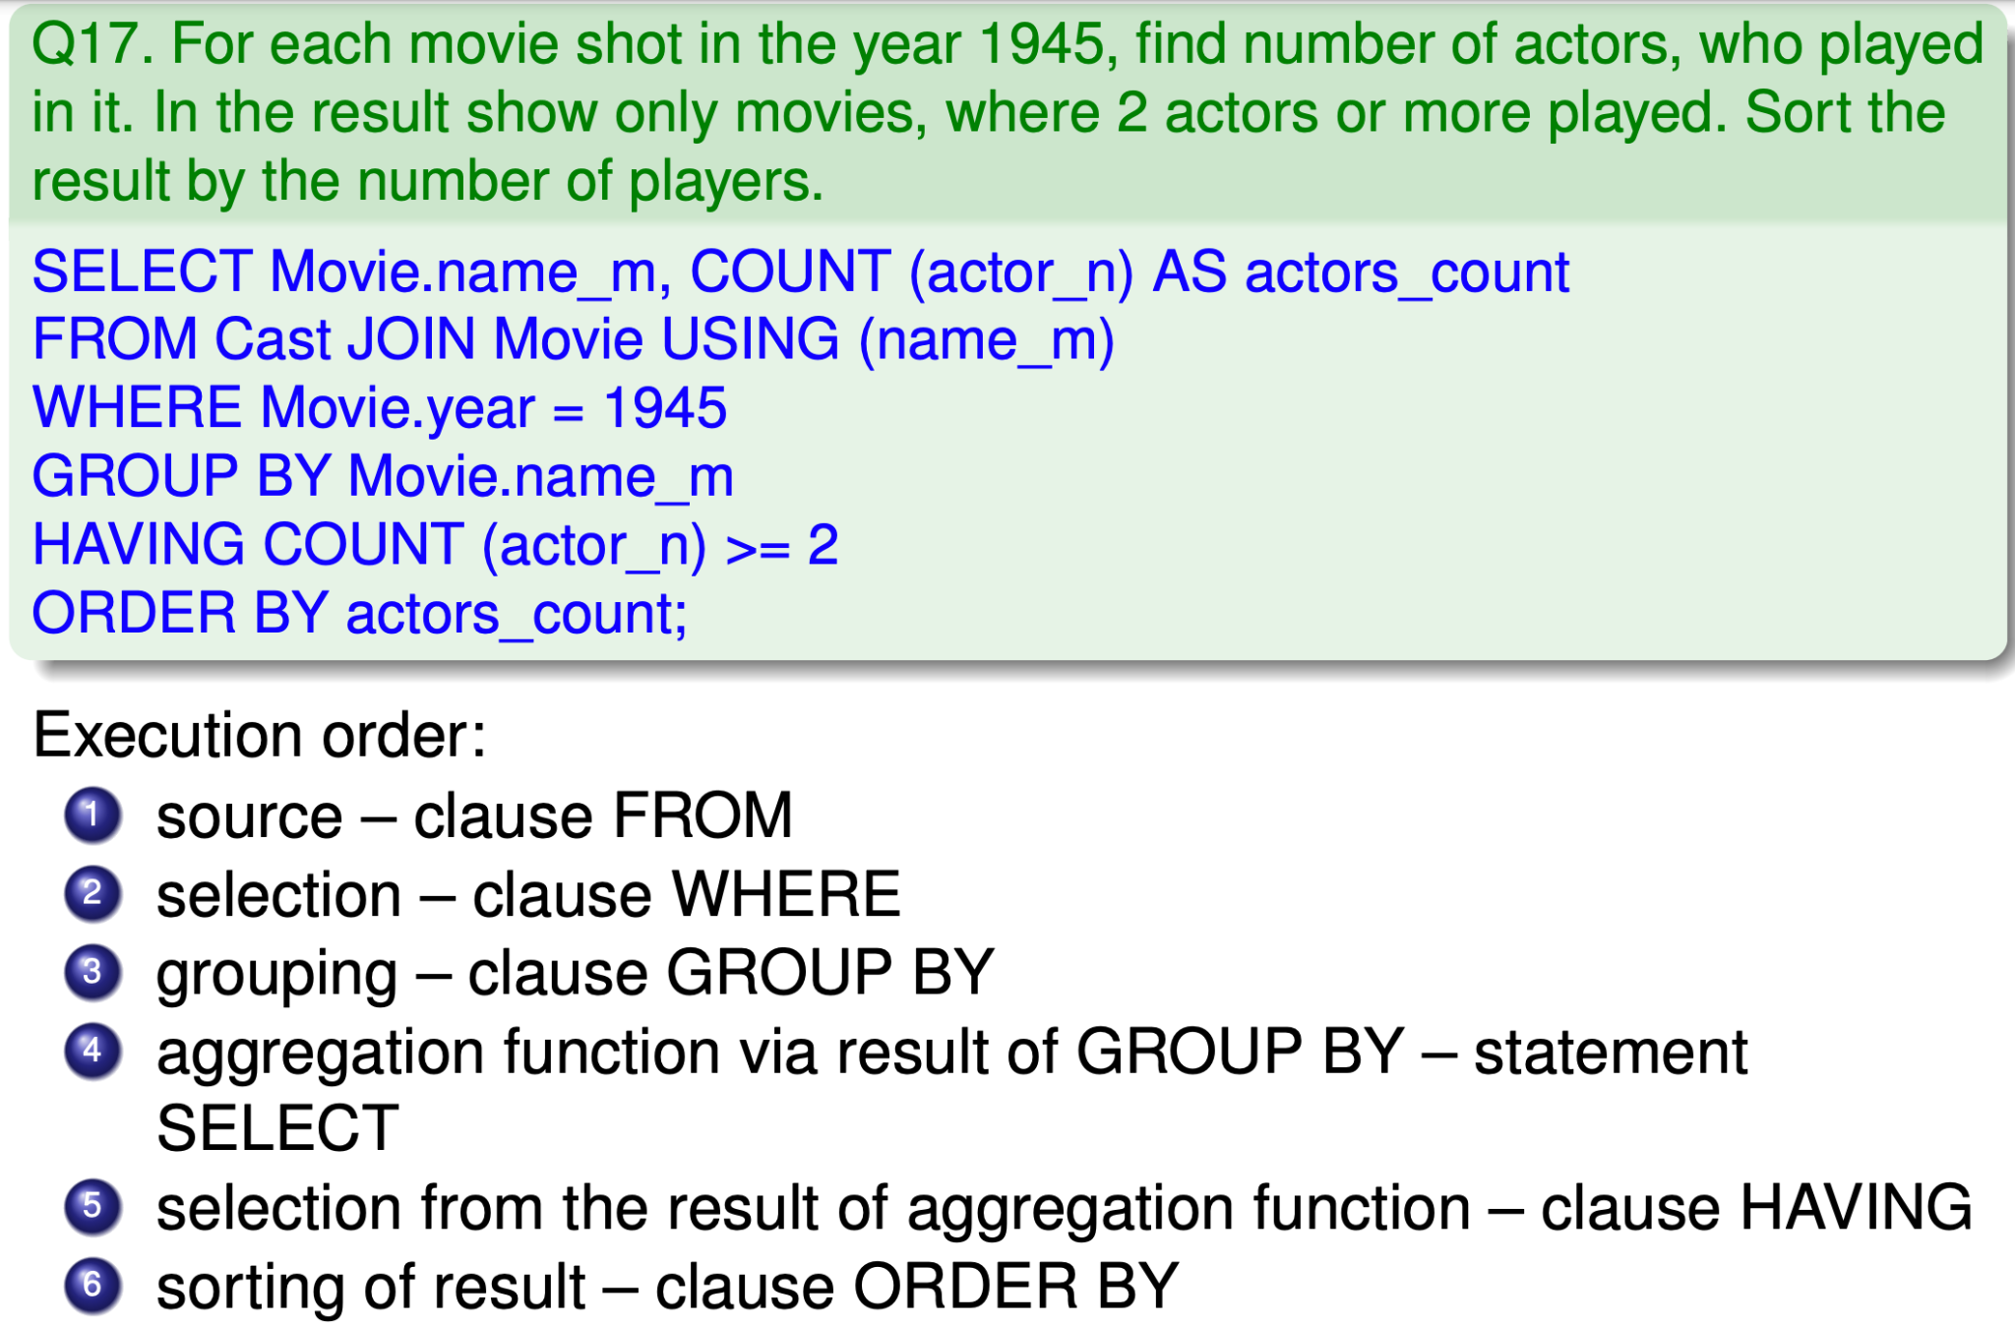
Execution order
Be careful on the syntax and order

Slide 9
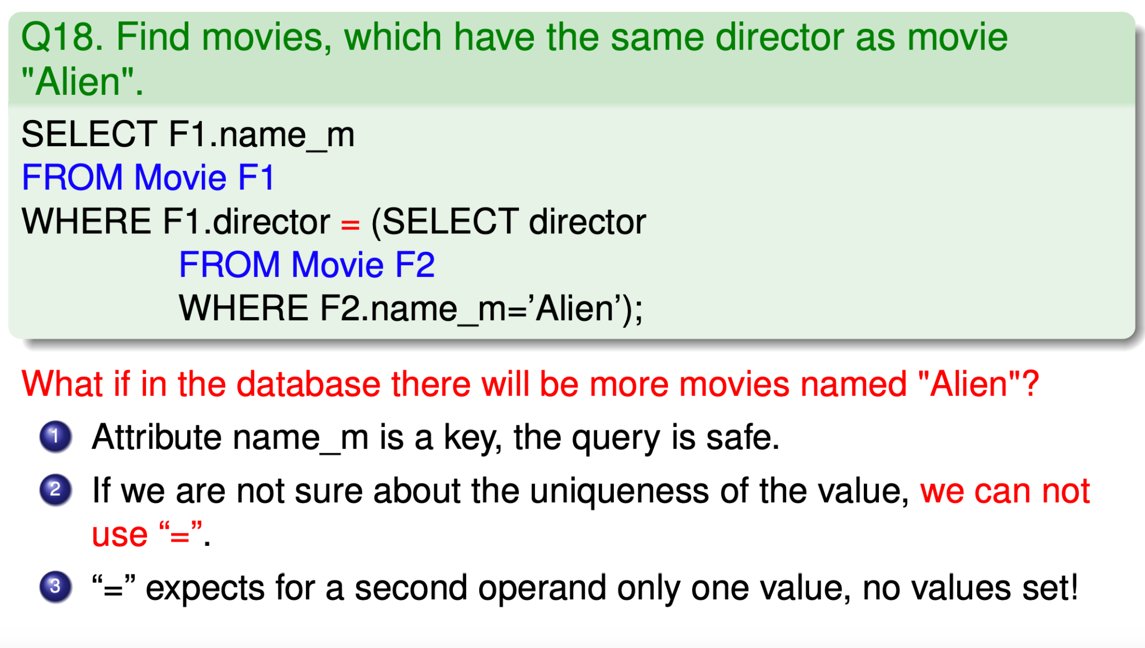
Non-correlated subquery

Slide 10
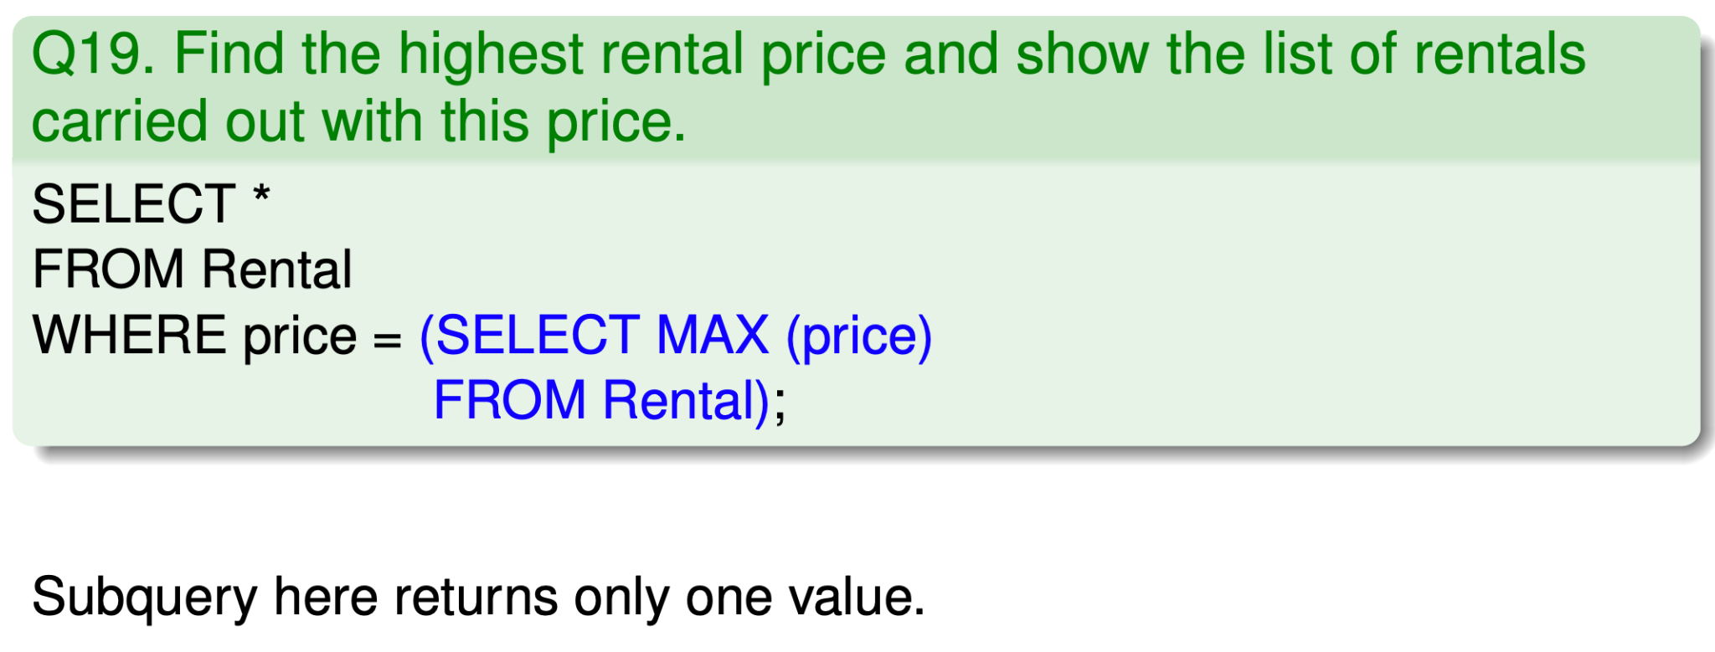
Non-correlated subquery

Slide 11
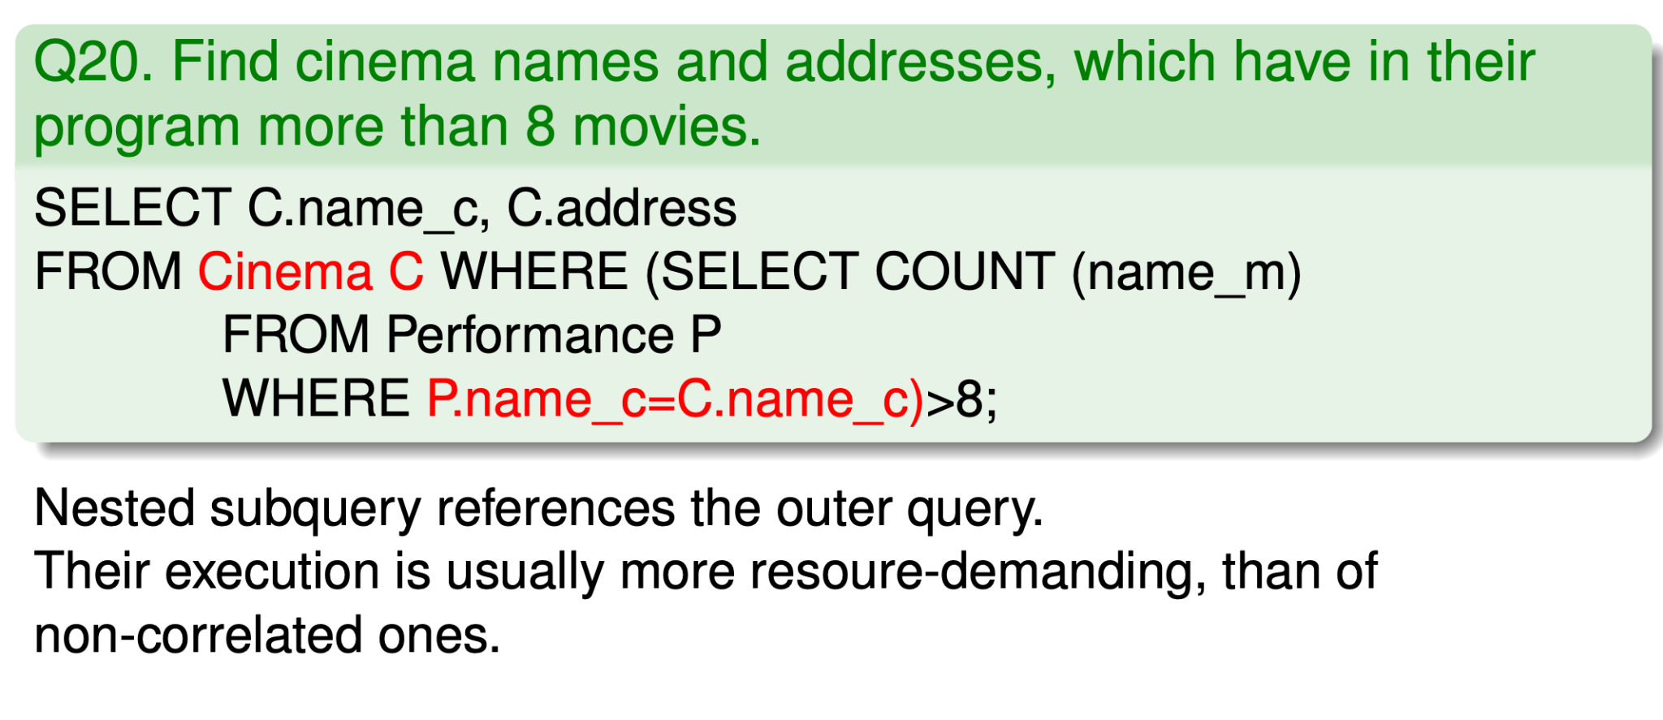
Correlated subquery

Slide 12
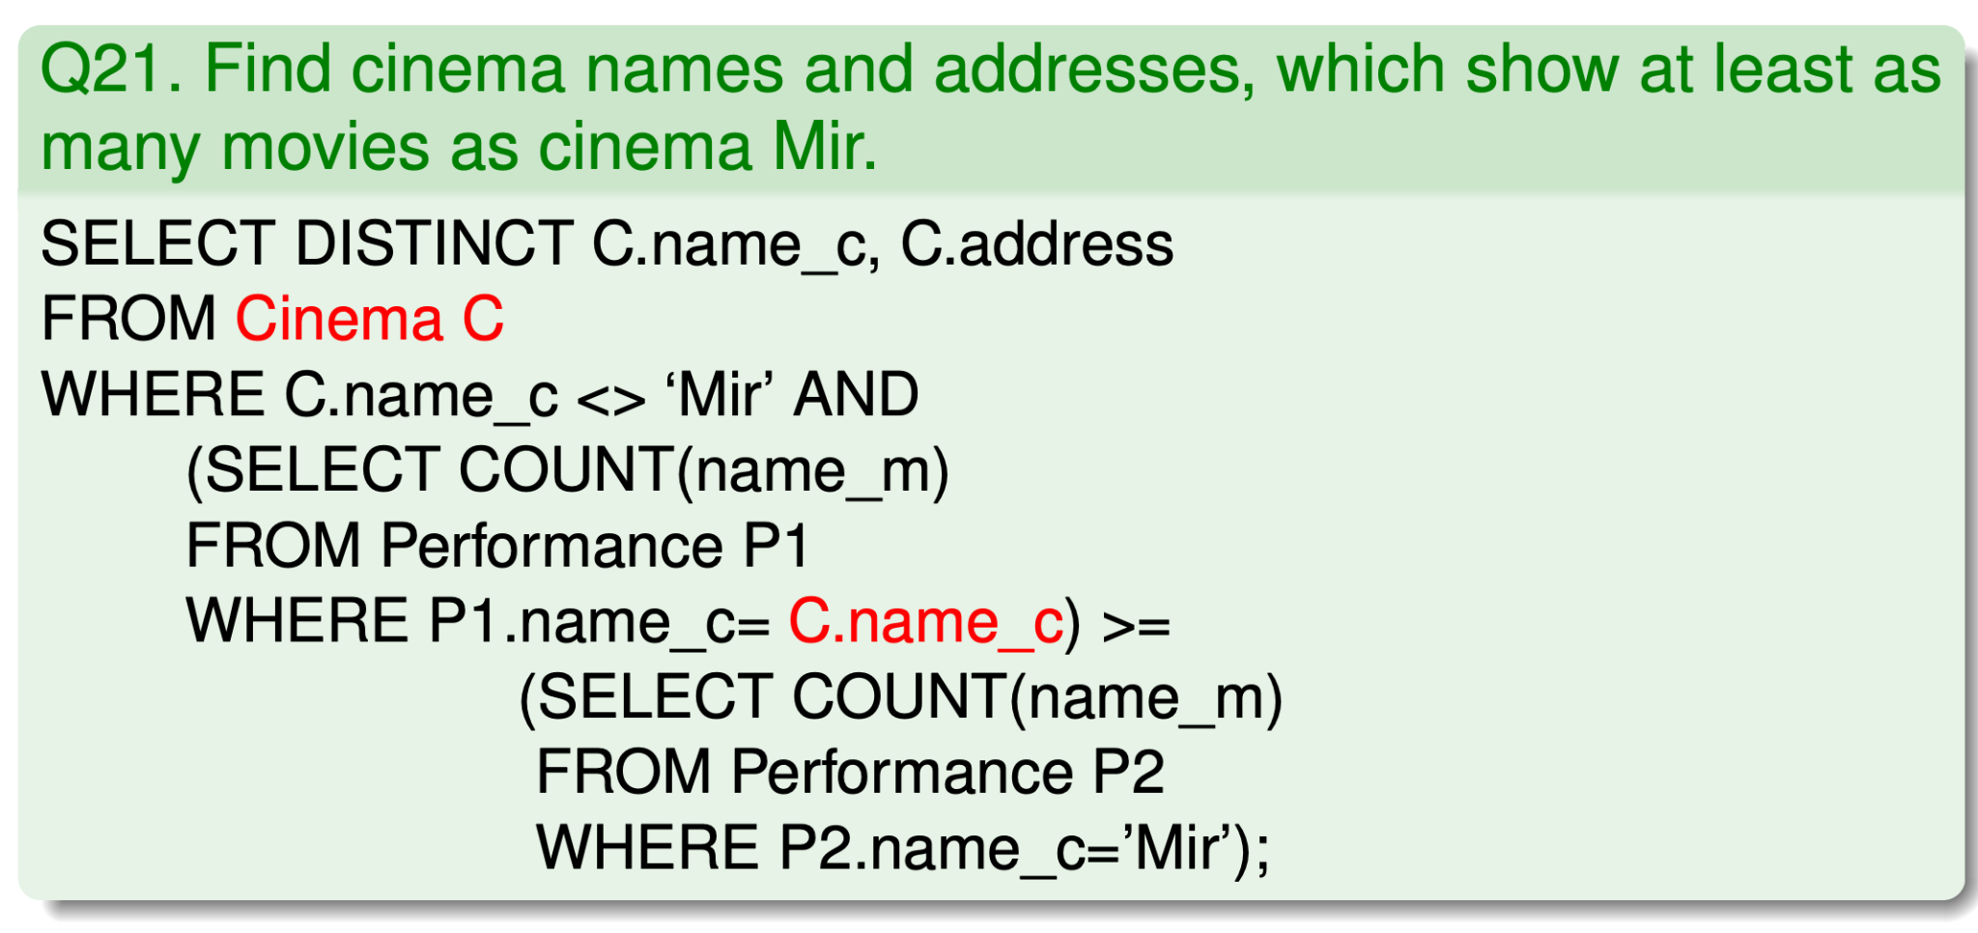
Correlated subquery

Slide 13
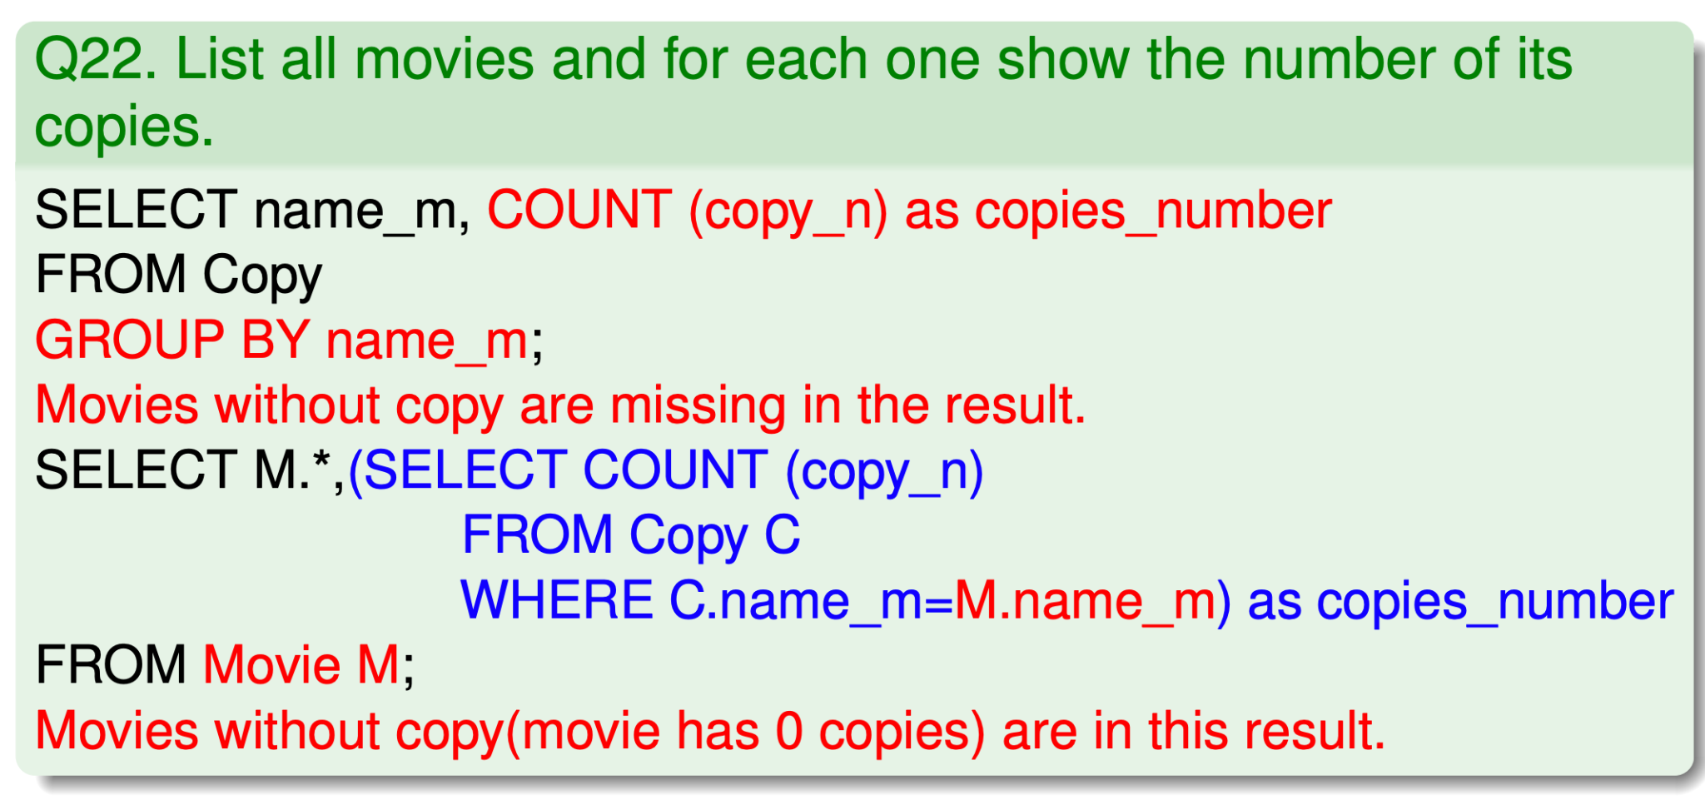
Subquery in SELECT statement

Slide 14
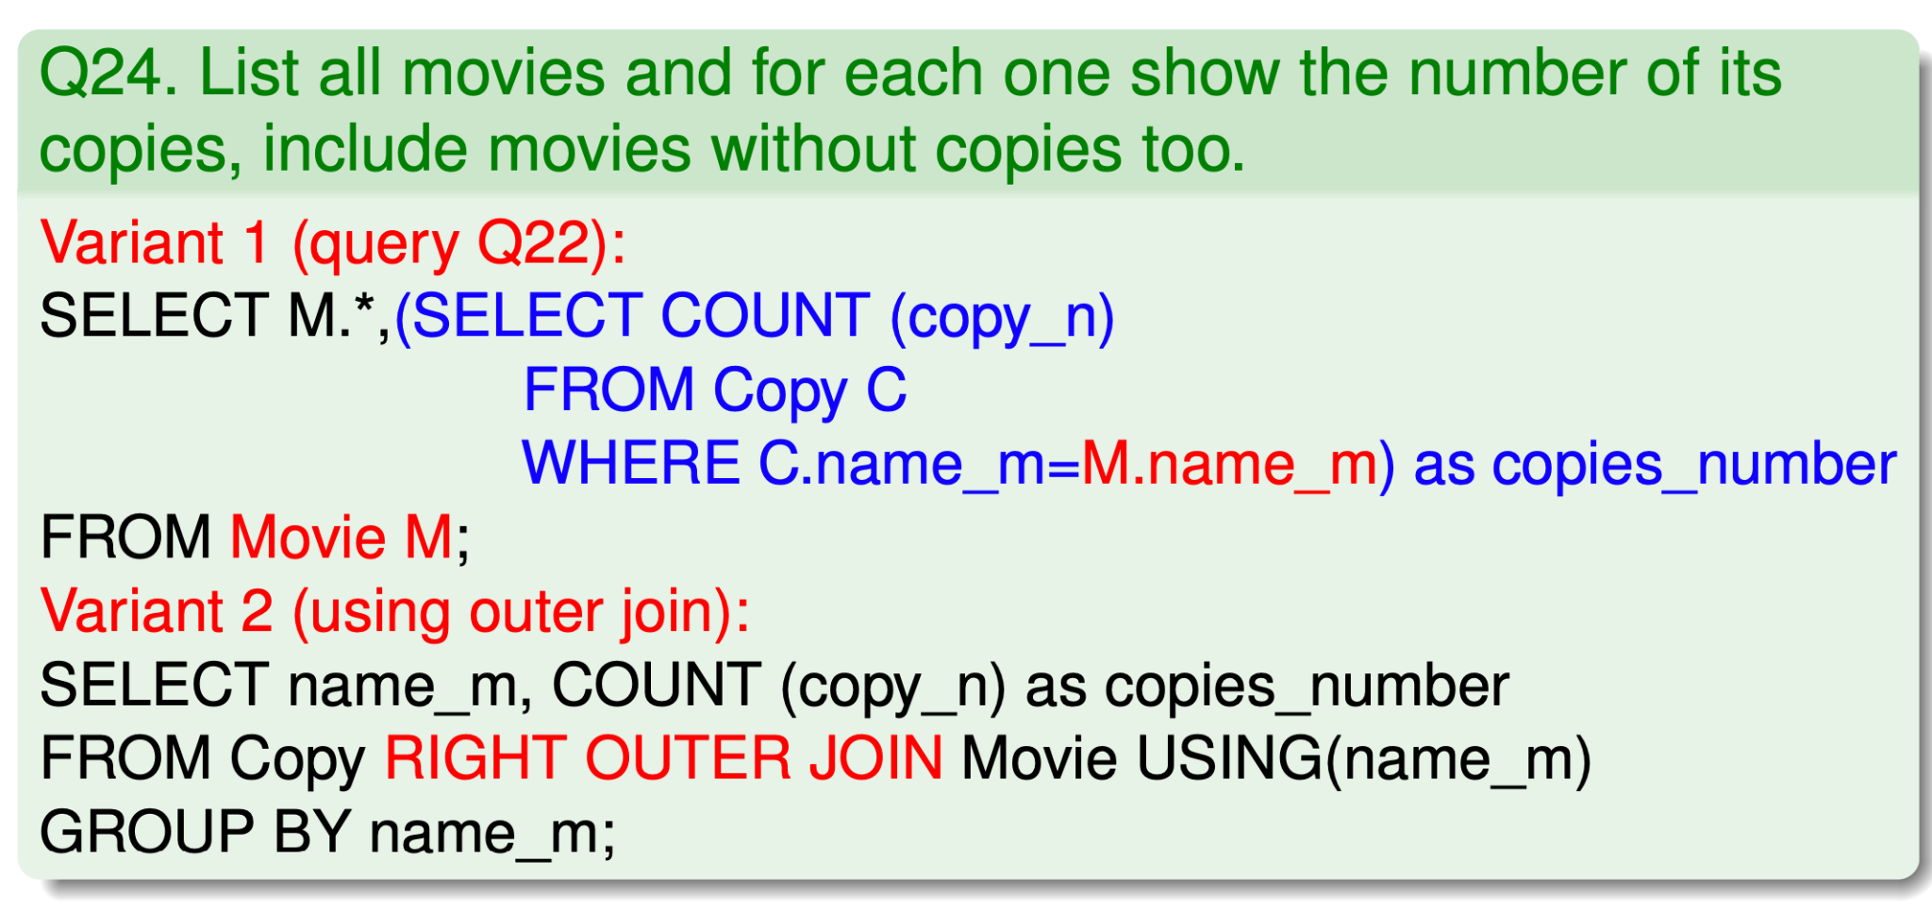
Outer Join

Slide 15
Attention, it is necessary to distinguish
outer join – SQL – Normal join + left/right/both relations add n-tuples, which at the opposite side of the relation don’t have partner (missing columns must be filled with NULL).
semi-join – RA – Reduction of one relation n-tuples to those, which are joinable with some n-tuple from second relation. Syntactic shortcut for join and following projection on attributes of left/right relation.
anti-join – RA – Reduction of one relation n-tuples to those, which are not joinable with some n-tuple from second relation. Syntactic shortcut for set subtraction of first relation and corresponding semi-join.

Slide 16
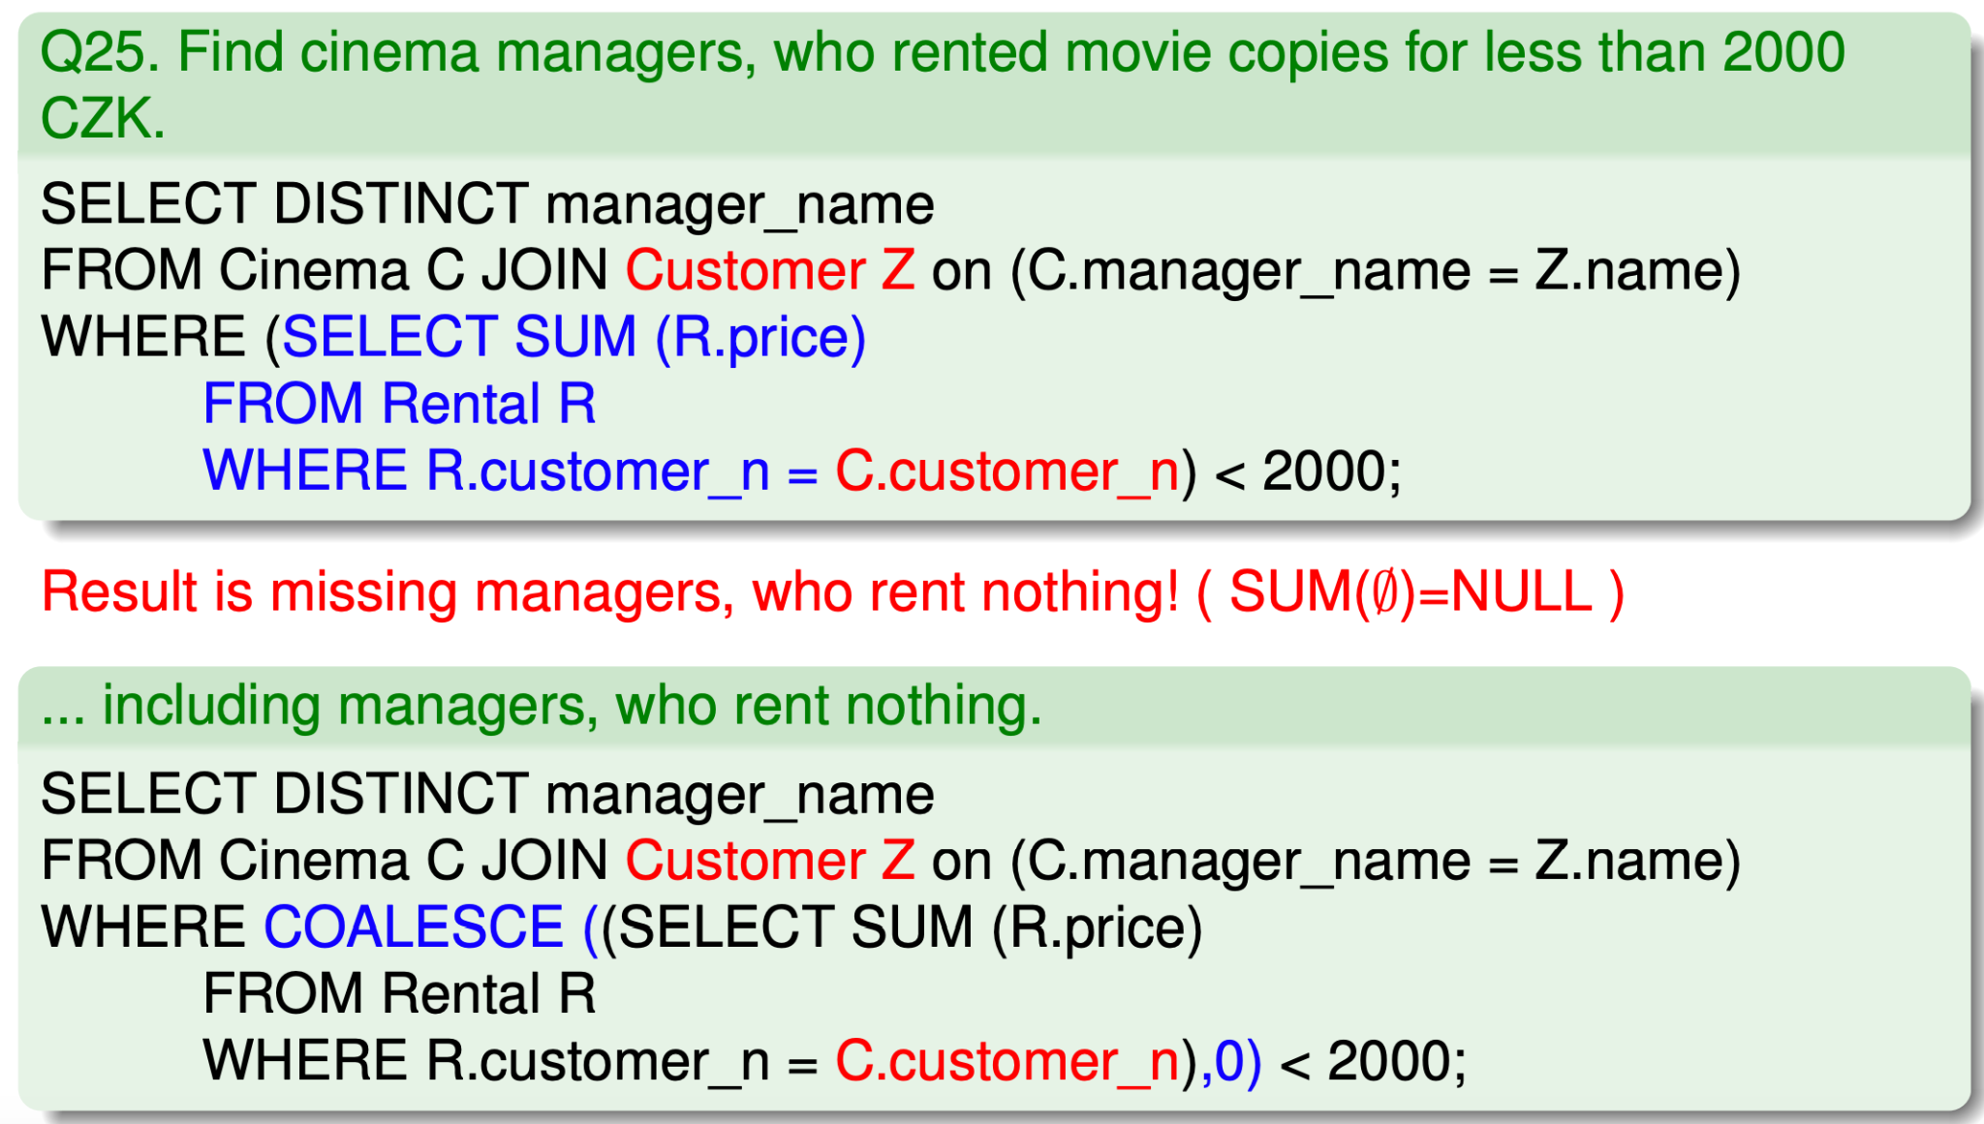
Aggregation and empty set

Slide 17
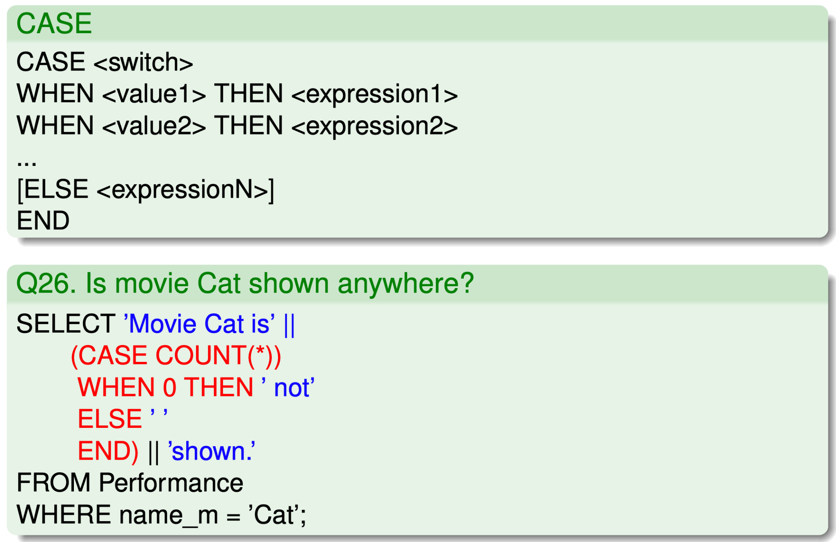
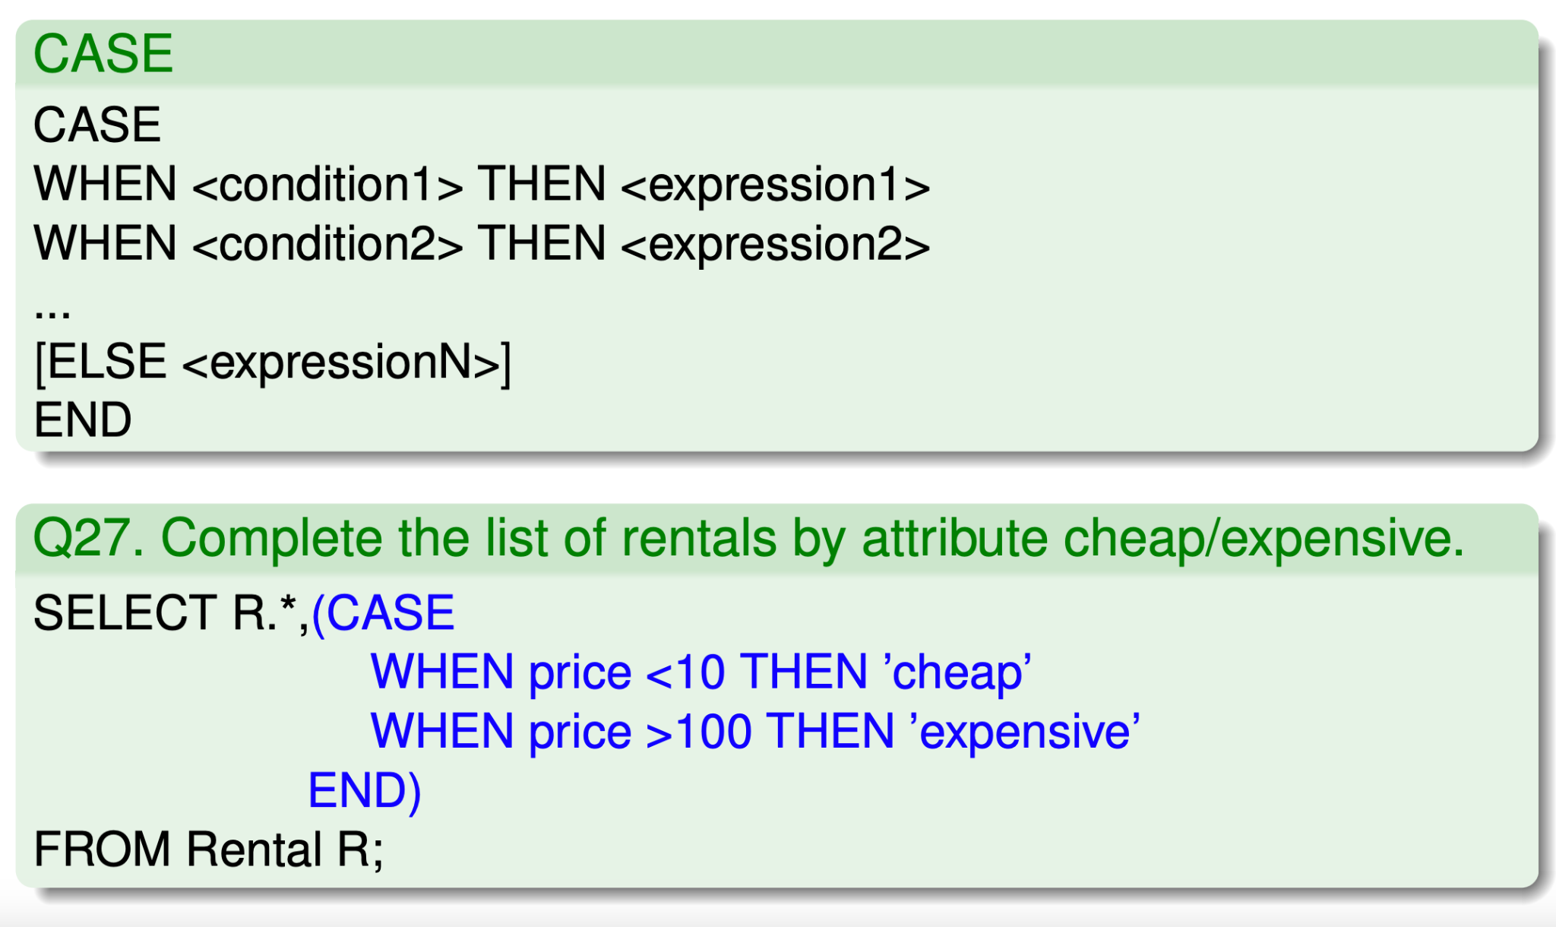
CASE

Slide 18
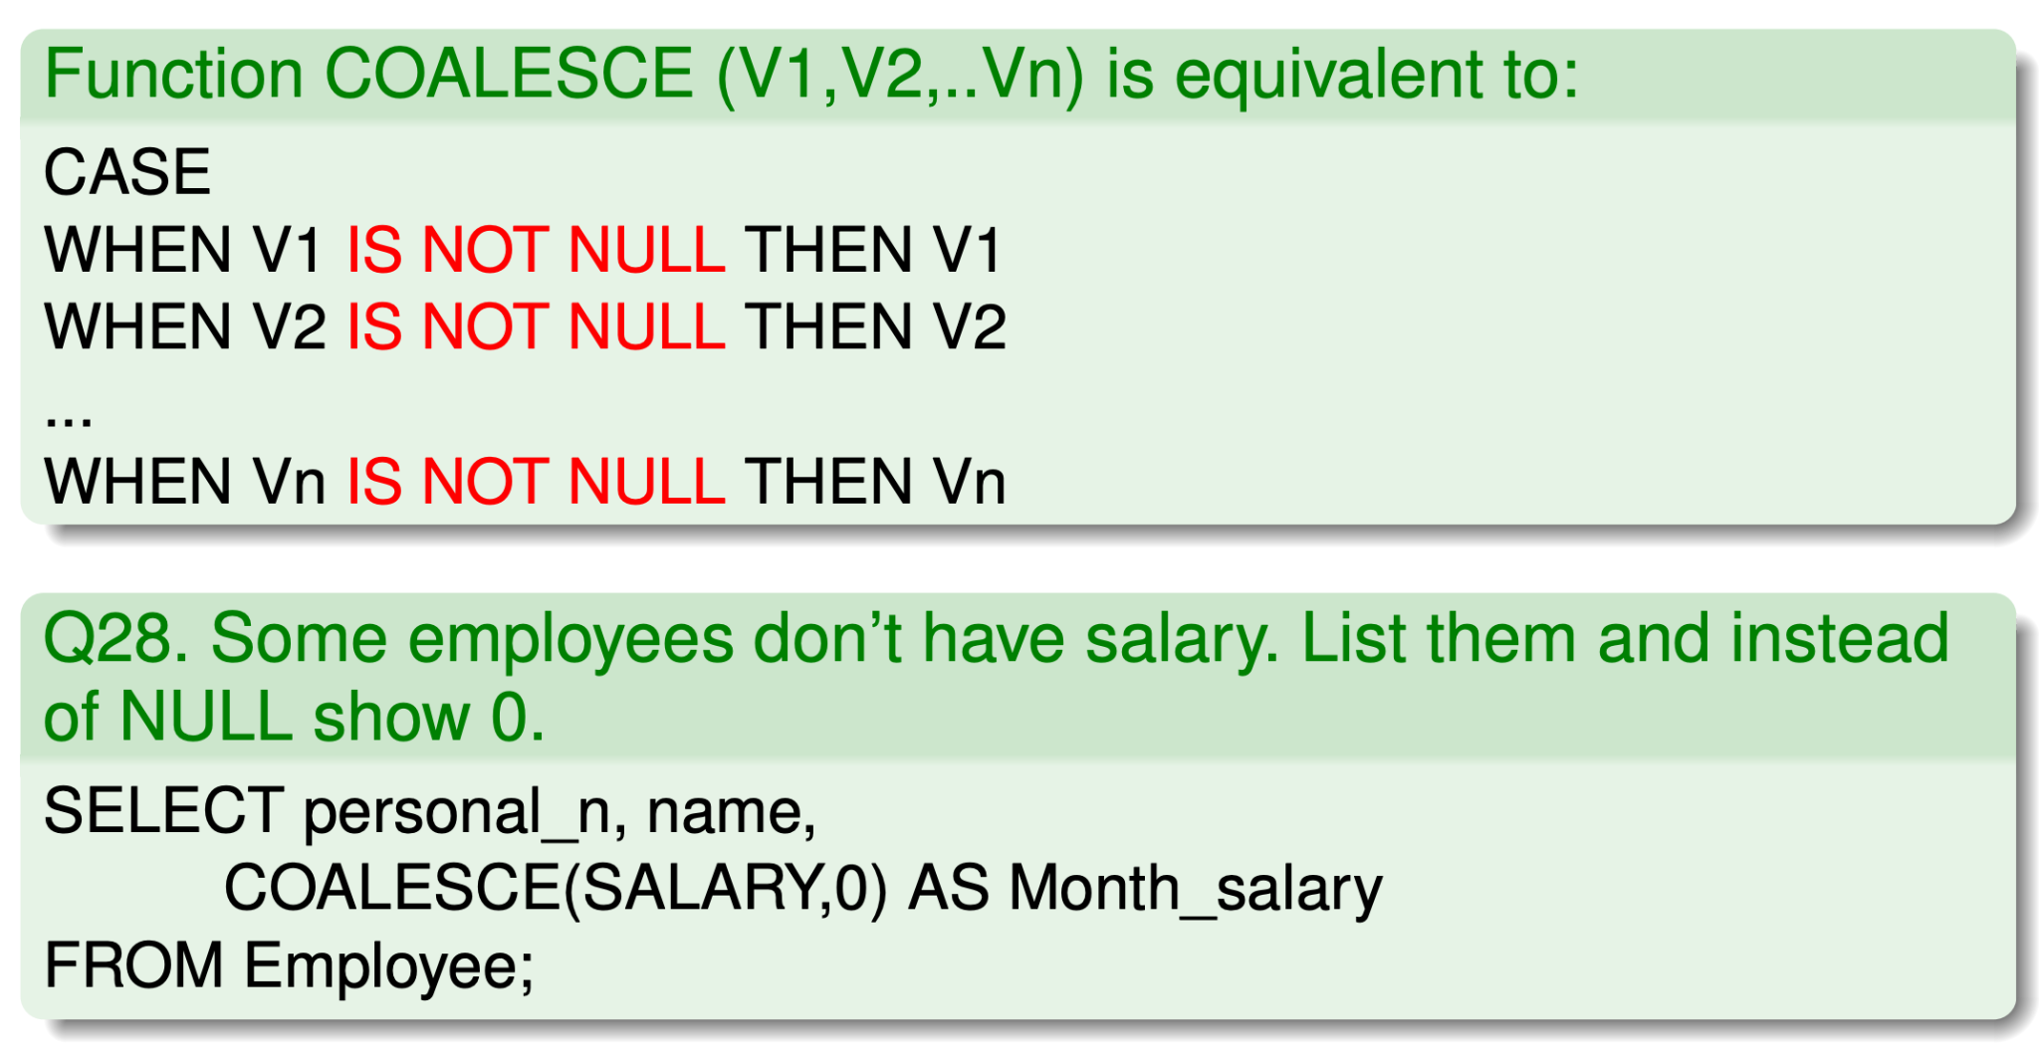
COALESCE

Slide 19
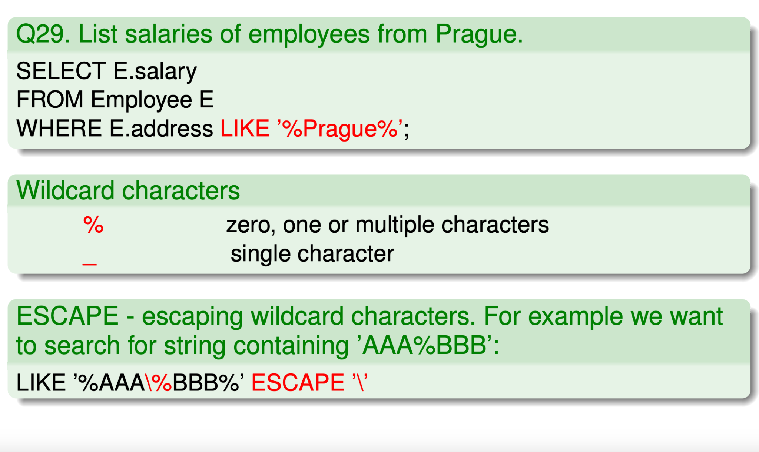
LIKE
It is preferable to use rather than the classical equation (=)

Slide 20
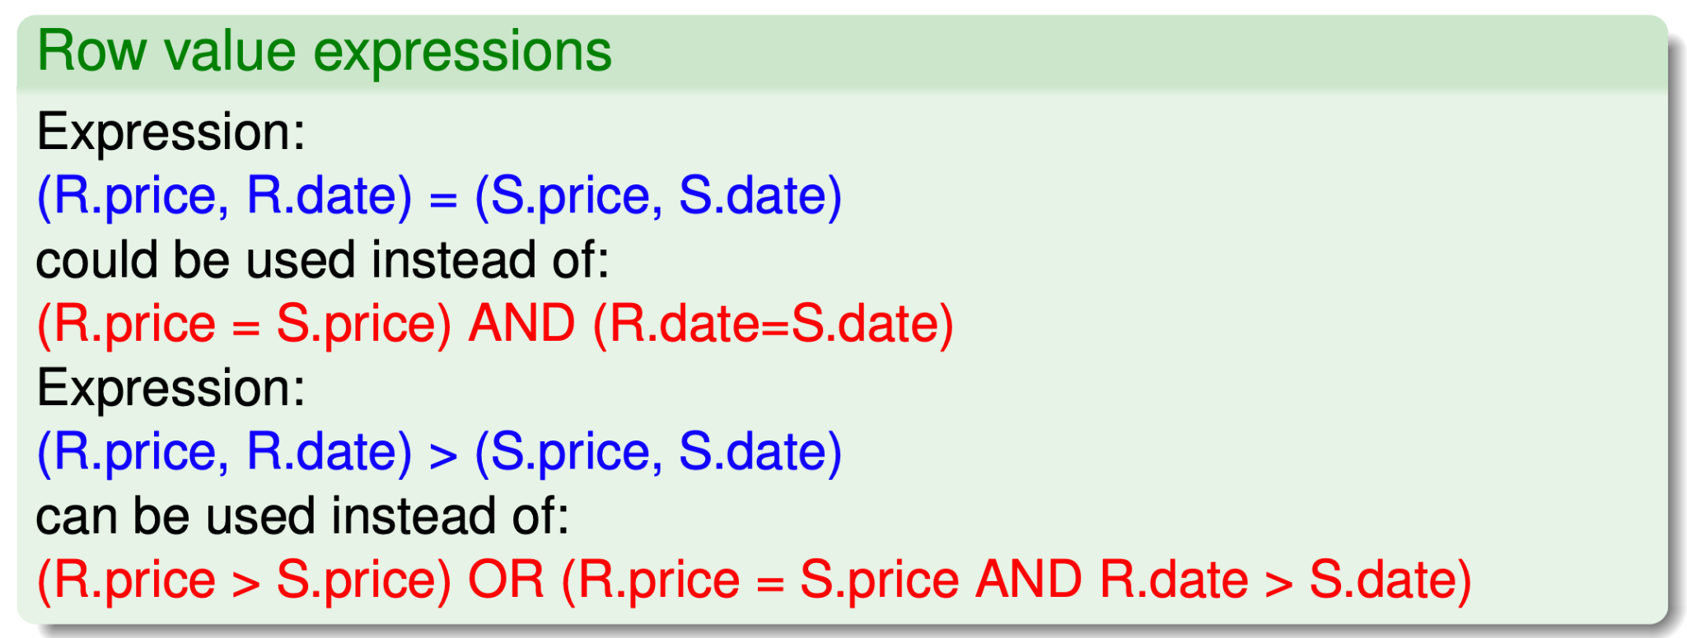
Row value expressions

Slide 21
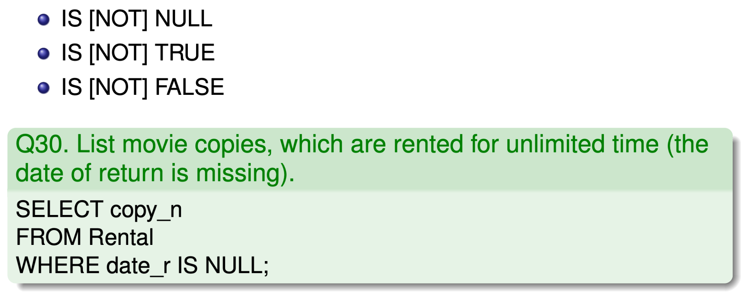
IS NULL

Slide 22
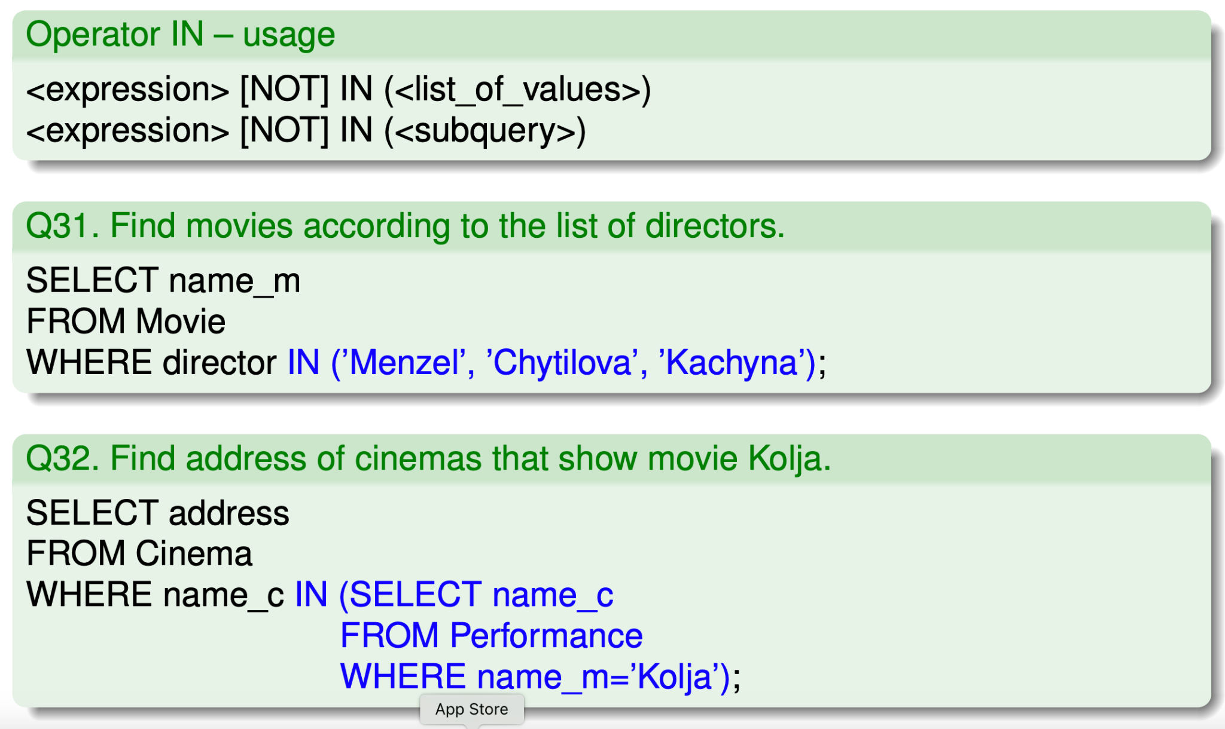
Operator IN

Slide 23
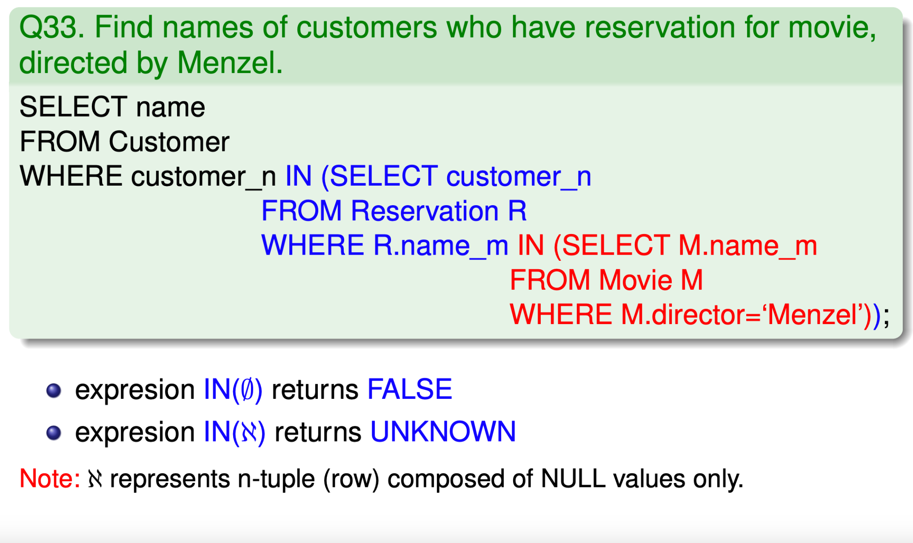
Operator IN

Slide 24
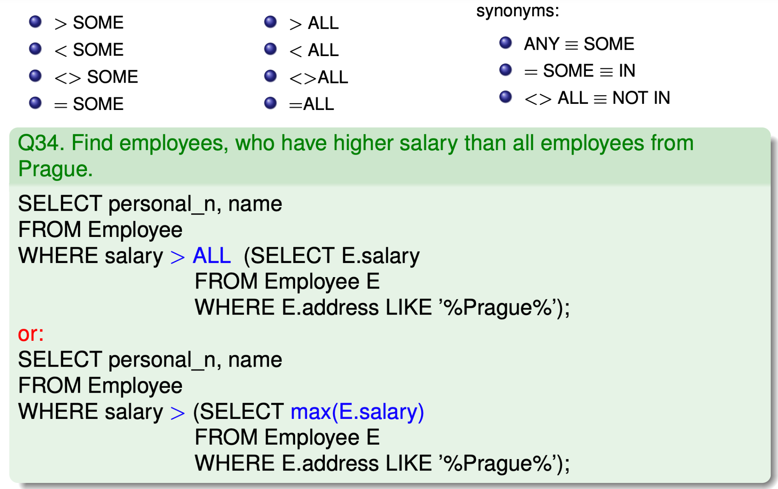
ANY, ALL, SOME

Slide 25
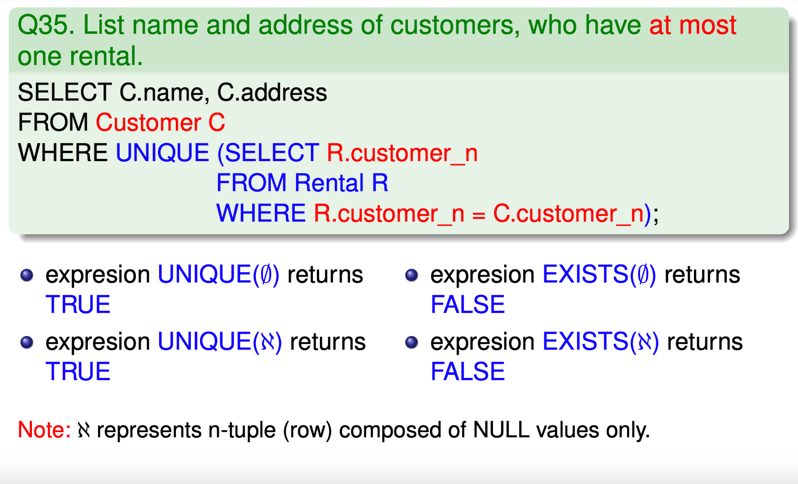
UNIQUE

Slide 26
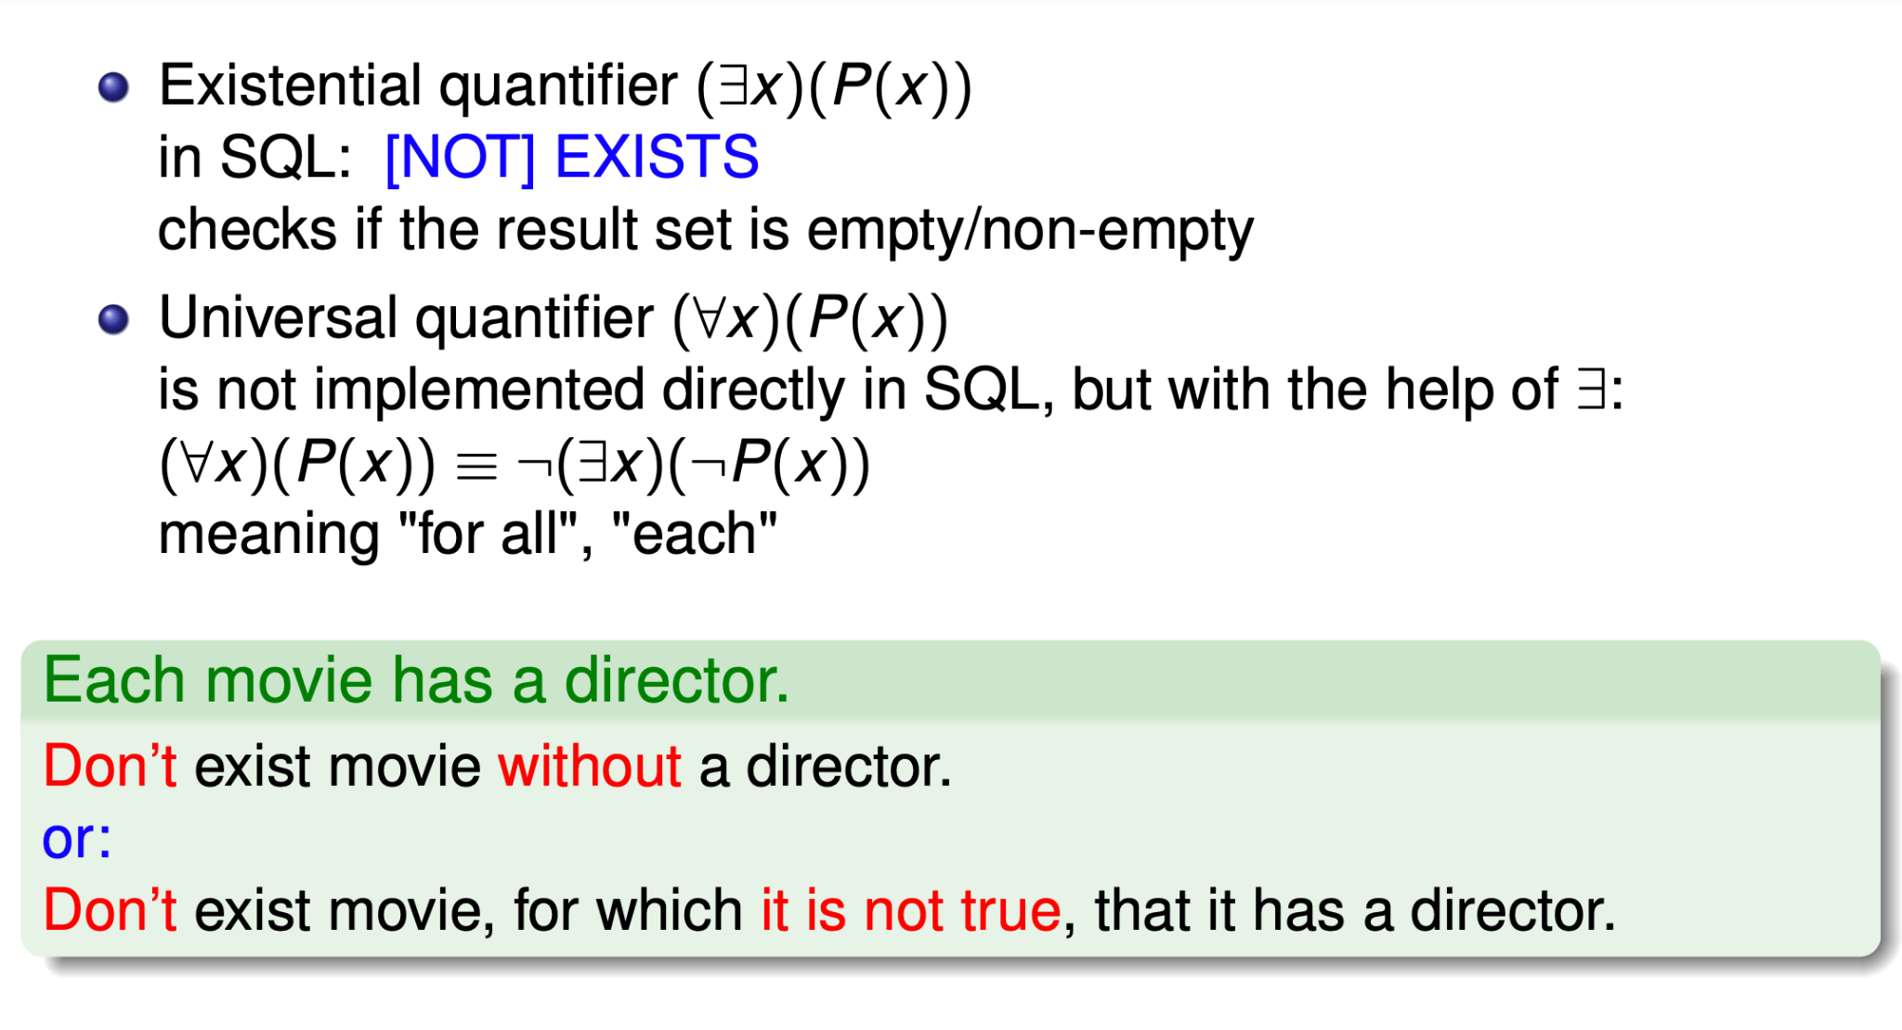
Quantifier

Slide 27
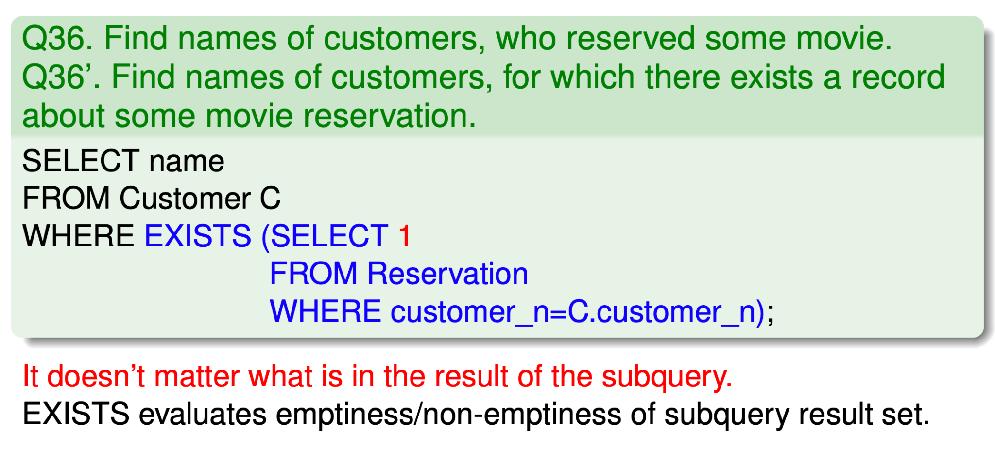
Quantifier

Slide 28
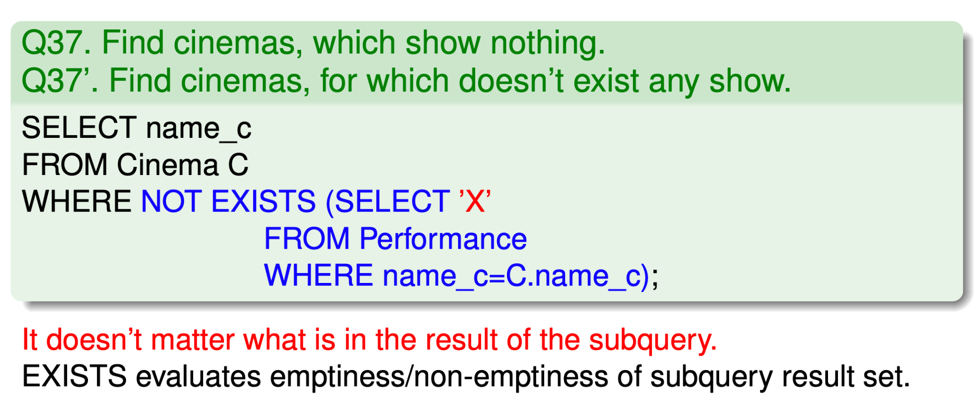
Quantifier

Slide 29
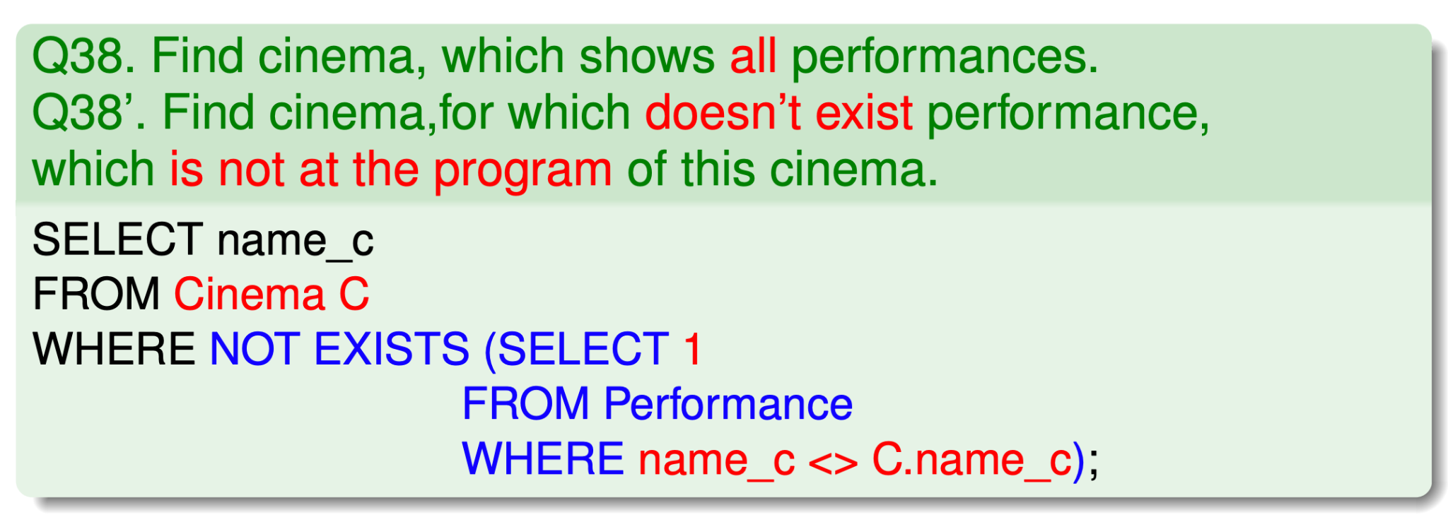
Quantifier

Slide 30
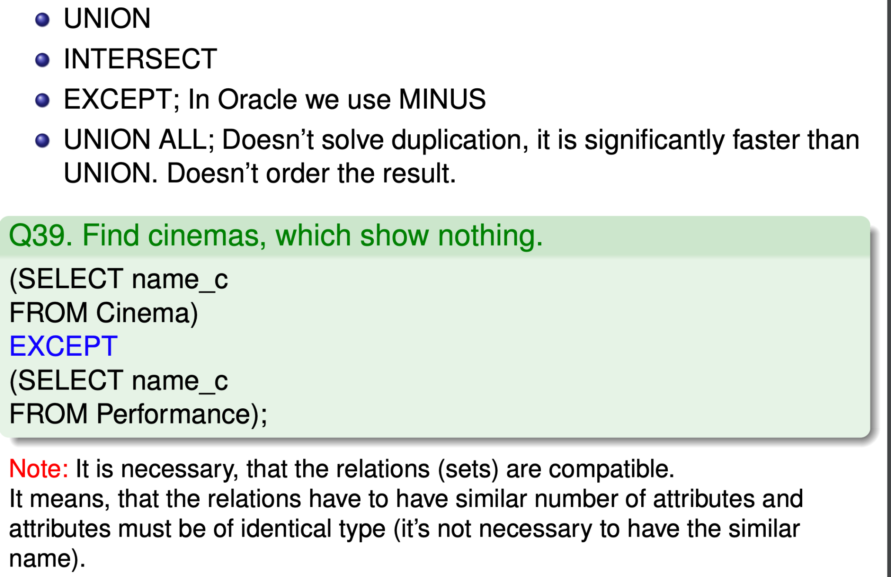
Set operations

Slide 31
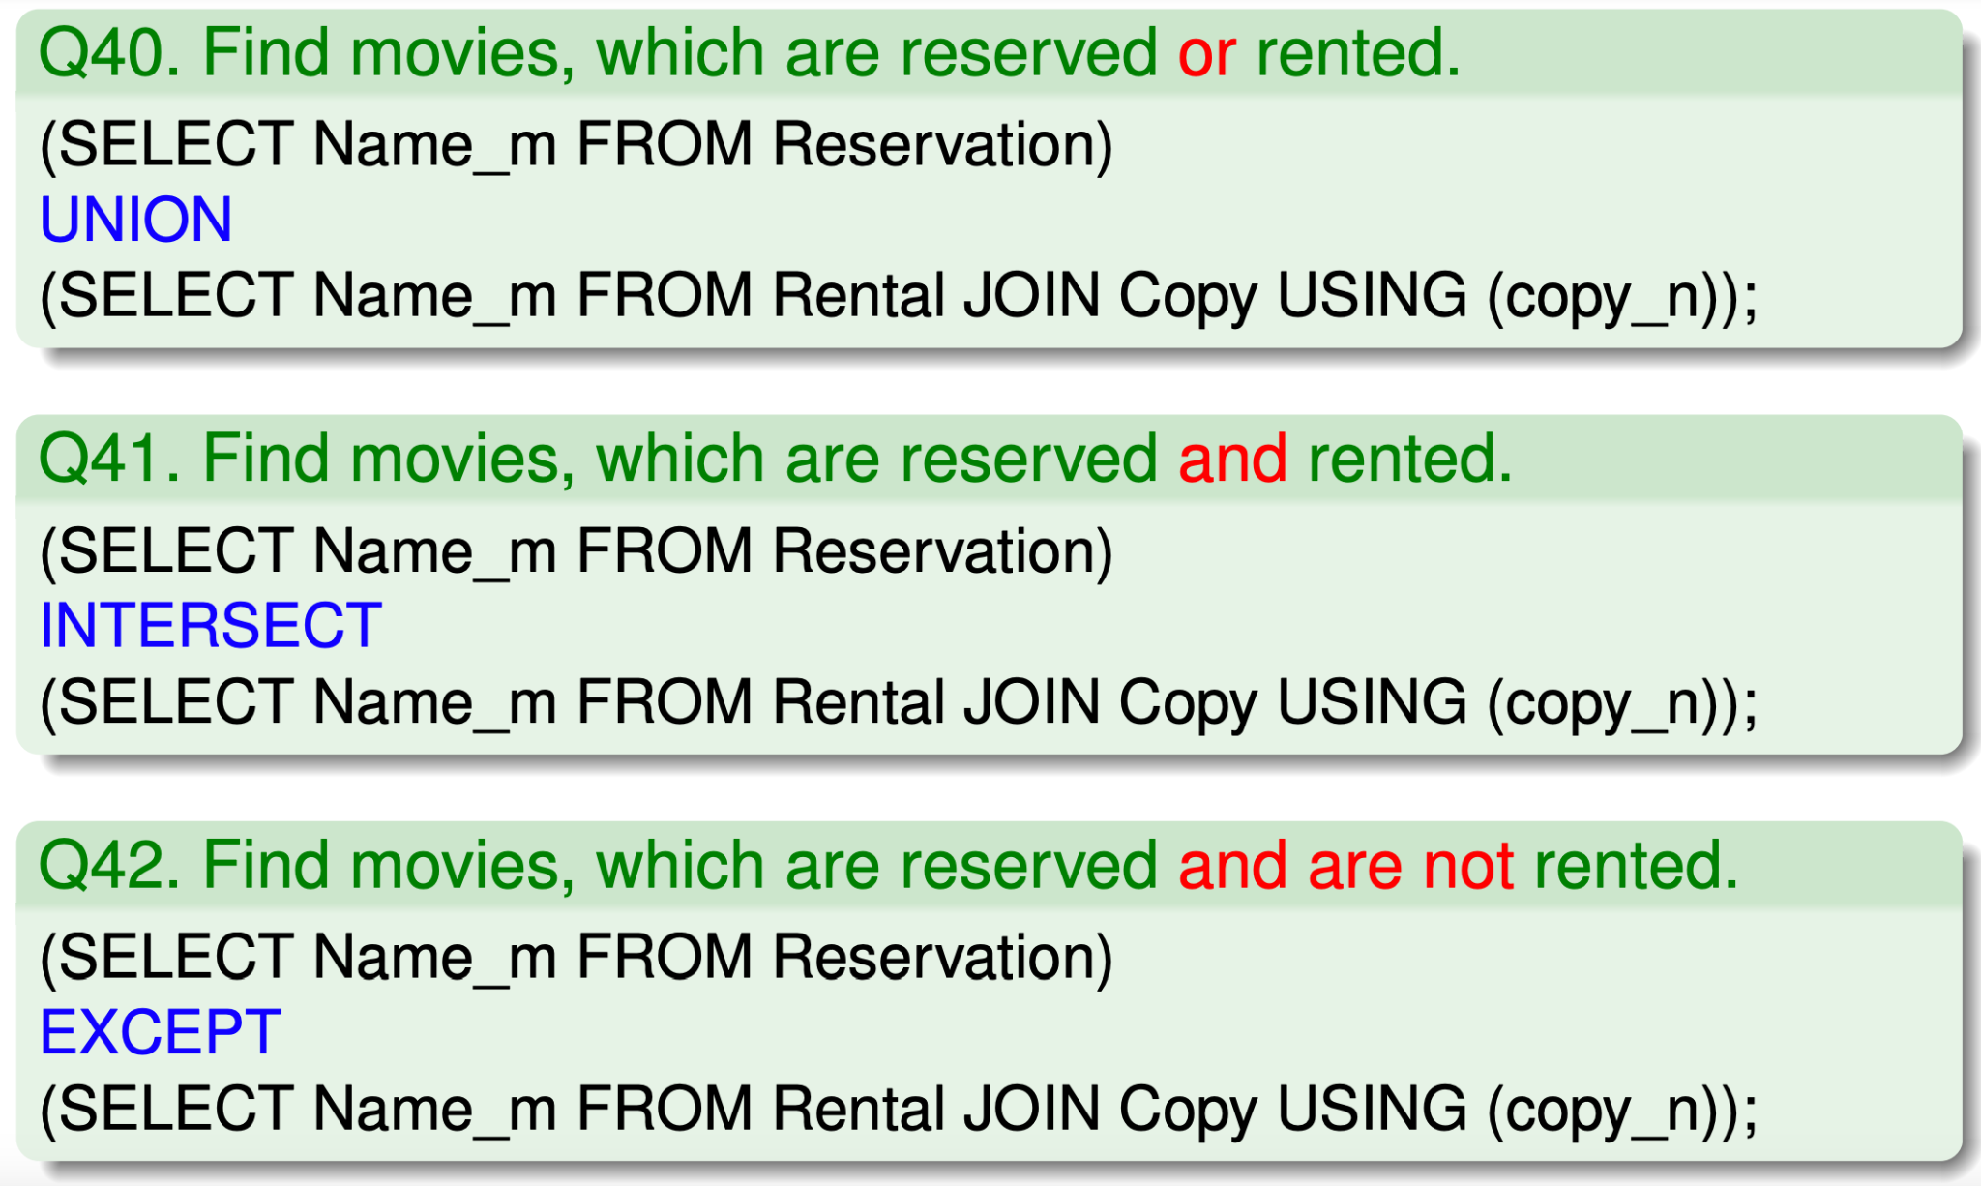
Set operations

Slide 32
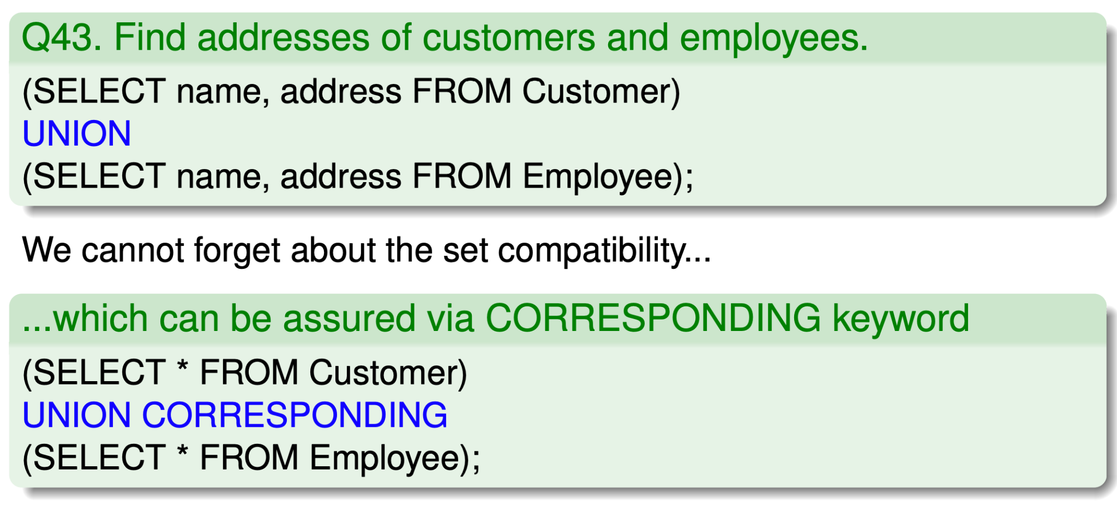
Set operations

Slide 33
What you should remember
Aggregation in SQL
Subqueries
Outer Join
Quantifier, using of multiple negation
Set operations in SQL

